Slide 1
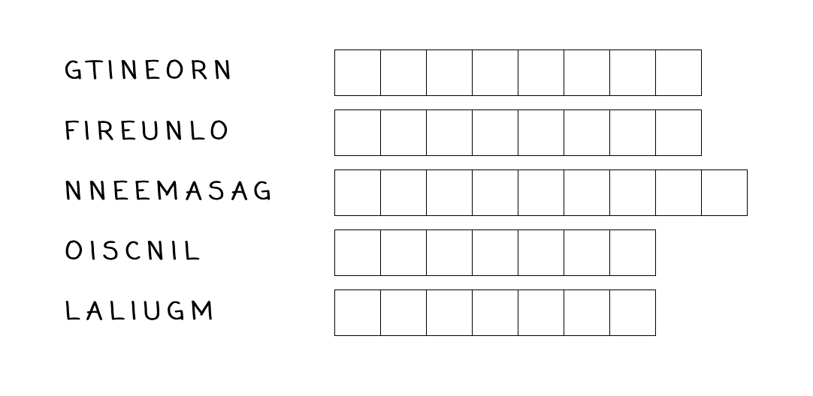
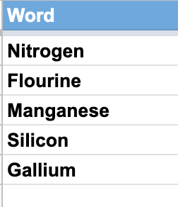
Do Now
Unscramble these elements!

Slide 2
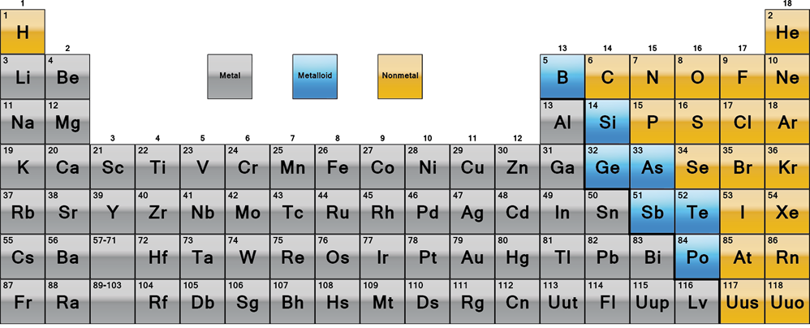
Daily Review
CFU 1
What three groups are the elements sorted into?
Elements on the periodic table are arranged according to their properties.
CFU 2
What is helium classified as?
Every element is either a metal, a non-metal or a metalloid.
CFU 3
What is potassium classified as?
CFU 4
What is boron classified as?

Slide 3
Daily Review
CFU 1
Why is copper used to make electrical wires?
Elements on the periodic table are arranged according to their properties.
CFU 2
Name a non-metal that is solid at room temperature and another that is a gas.
Metals | Non-metals
Left side of periodic table | Right side of periodic table
Shiny | Dull
Conduct electricity | Do not conduct electricity (except C, as graphite)
Malleable | Brittle
Solid (except Hg) | Various states
Vocabulary
malleable (adjective) can change shape without breaking or cracking brittle (adjective) hard, but cannot change shape without breaking or cracking
Notes:
HOOK ACTIVITY
Shiny = metal (non-metal=dull)
Right side of periodic table = non-metal (metal=left side)
Does not conduct electricity = non-metal (metal=conducts electricity)
EXCEPT for what? Carbon in the form of graphite
Malleable = metal (non-metal=brittle)
Liquid at room temperature
Trick question!!
Metals=solid EXCEPT for Mercury (Hg)
Non-metal=various states

Slide 4
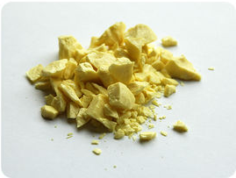
Daily Review
Elements with the same classification (metal, non-metal or metalloid) share similar properties.
Sulfur is a solid at room temperature. What would happen if you tried to bend it? How do you know?
Sulfur would break if you tried to bend it. Sulfur is a non-metal and is brittle.

Slide 5
Molecules, Compounds & Mixtures Year 8 Science

Slide 6

Learning Objectives
CFU
What are we going to compare and contrast?
Define molecule and compound
Compare and contrast atoms, molecules, elements and compounds
Identify the types and number of atoms in a compound
Activate Prior Knowledge
When using diagrams to show different substances, scientists may use different colours to represent different elements.
In this mixture, how many different elements can you identify?

Slide 7
Concept Development
CFU 1
How is a compound different to a molecule?
Atoms bond together to make molecules and compounds.
CFU 2
How is a compound different to an element?
Molecules:
Groups of two or more atoms that are bonded together.
The atoms can be the same element (molecular element)
or different elements (molecular compound).
Molecules
Compounds
Elements

Slide 8
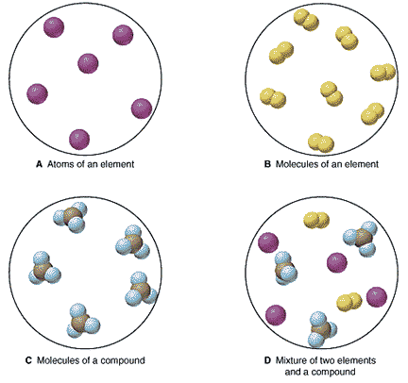
Concept Development
CFU 1
What is a pure substance?
Atoms bond together to make molecules and compounds.
Elements and compounds are pure substances.
The particles within a pure substance (whether they are atoms or molecules) are all the same.
Compounds are different to mixtures, in which different atoms / molecules are combined but are not bonded together.
CFU 2
How is a compound different to a mixture?
CFU 3
True or False: mixtures can be pure substances.

Slide 9

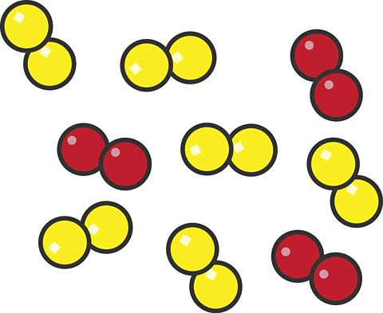
Concept Development
Atoms bond together to make molecules and compounds.
Mixtures:
Groups of two or more elements or compounds that are NOT chemically bonded together.
No reaction between substances
Can be separated into their components by chemical or physical means
CFU 1
How is a mixture different to a molecule?

Slide 10
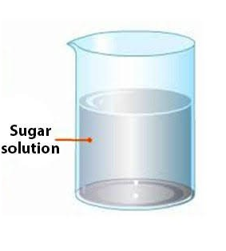
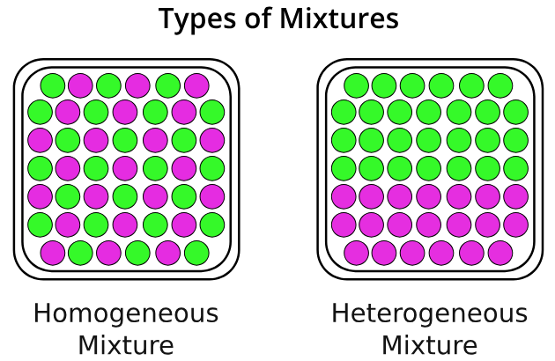
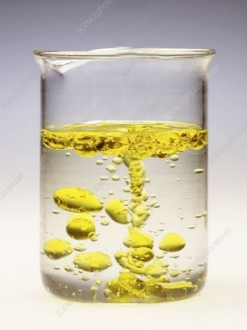
Concept Development
Mixtures can be classified into 2 main categories
Homogenous :
Uniform distribution of components
Individual components are not easily distinguishable
E.g. Sugar dissolved in water – forms a clear solution
Heterogenous :
Non-uniform distribution of components
Individual components are often visible and distinguishable
E.g. Oil and water

Slide 11
Skill Development / Guided Practice
CFU 1
What does the formula for a chemical compound describe?
We use chemical formulae to show the types and numbers of atoms that make up molecules.
A basic skill in chemistry is the ability to write and understand chemical formulae (plural of formula).
The formula for a chemical compound describes the number and type of atoms within a molecule.
The element symbols tell us the types of atoms present.
The numbers written after the element symbols tell us the number of each type of atom present.
CFU 2
How can we tell what type of atoms are present in a chemical formula?
CFU 3
How can we tell how many atoms are present in a chemical formula?

Slide 12
Skill Development / Guided Practice
CFU 1
What does the chemical formula for water tell us?
We use chemical formulae to show the types and numbers of atoms that make up molecules.
CFU 2
How many hydrogen atoms are in one water molecule?
Chemical formula for water: H₂O
The chemical formula for water tells us the number and type of atoms in water.
There are 2 hydrogen atoms in one water molecule.
There is 1 oxygen atom in one water molecule.
There are a total of 3 atoms in one water molecule.
CFU 3
In total, how many atoms are there in one water molecule?
Reminder:
Each new atom begins with a CAPITAL letter.

Slide 13
Skill Development / Guided Practice
CFU 1
What does the chemical formula for carbon dioxide tell us?
We use a chemical formula to show the types and numbers of atoms that make up molecules.
Chemical formula for carbon dioxide: CO₂
The chemical formula for carbon dioxide tells us the number and type of atoms in carbon dioxide.
How many carbon atoms are in one carbon dioxide molecule?
There is 1 carbon atom in one carbon dioxide molecule.
How many oxygen atoms are in one carbon dioxide molecule?
There are 2 oxygen atoms in one carbon dioxide molecule.
How many atoms are in one carbon dioxide molecule?
There are a total of 3 atoms in one carbon dioxide
molecule.
CFU 2
How many carbon atoms are in one carbon dioxide molecule?
CFU 3
In total, how many atoms are there in one carbon dioxide molecule?
Reminder:
Each new atom begins with a CAPITAL letter.

Slide 14
Skill Development / Guided Practice
CFU 1
How many calcium atoms are in one calcium carbonate molecule?
We use a chemical formula to show the types and numbers of atoms that make up molecules.
Chemical formula for calcium carbonate: CaCO₃
How many different elements are in one calcium carbonate molecule?
There are 3 different elements in one calcium carbonate molecule – calcium, carbon and oxygen.
How many atoms are in one calcium carbonate molecule?
There are a total of 5 atoms in one calcium carbonate
molecule.
CFU 2
How many carbon atoms are in one calcium carbonate molecule?
CFU 3
How many oxygen atoms are in one calcium carbonate molecule?
Reminder:
Each new atom begins with a CAPITAL letter.

Slide 15
Relevance
Knowing whether a substance is an element, compound or mixture will affect its use.
Identifying the type and number of atoms in a substance helps us determine its structure and properties.
Understanding chemical formulae allows you to understand and predict chemical reactions.

Slide 16
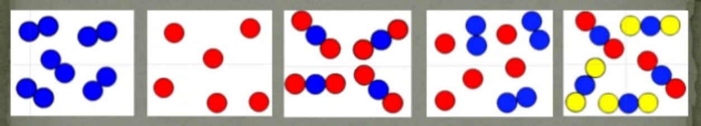
Skill Closure
Which of the images represent elements?
A B C D E
Skill Closure
Which of the images represents a compound?
Skill Closure
Identify the type and number of all different atoms in sodium phosphate, NaPO₄.

Slide 17

Independent Practice
Complete the Elements and Compounds worksheet by:
Downloading from Connect on your device
Collecting a printout from your teacher

